Slide 1
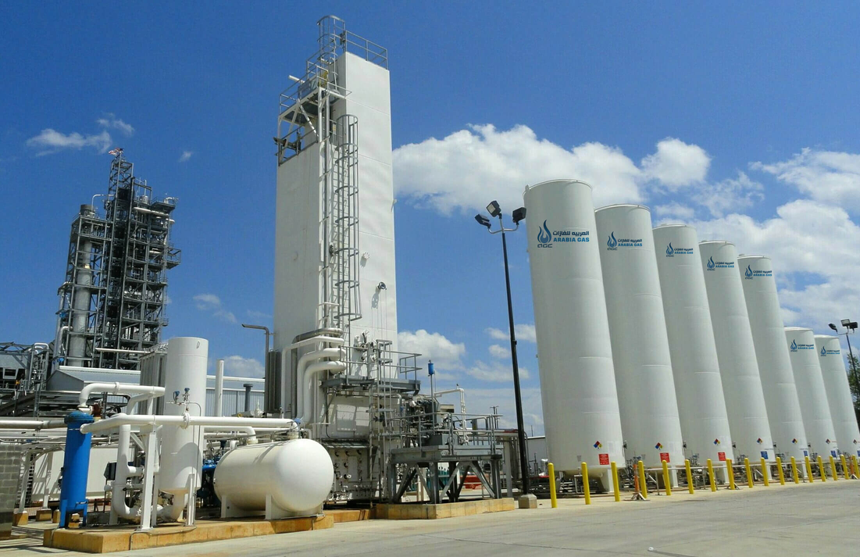

Group 8 :
Natural disaster sensor for industry
Đoàn Duy Long - 22070843
Ma Thanh Tùng - 22070904

Slide 2


Overview
Introduction
Our Mission
TOOl
Warning SMS and Blink data
Conclusion

Slide 3
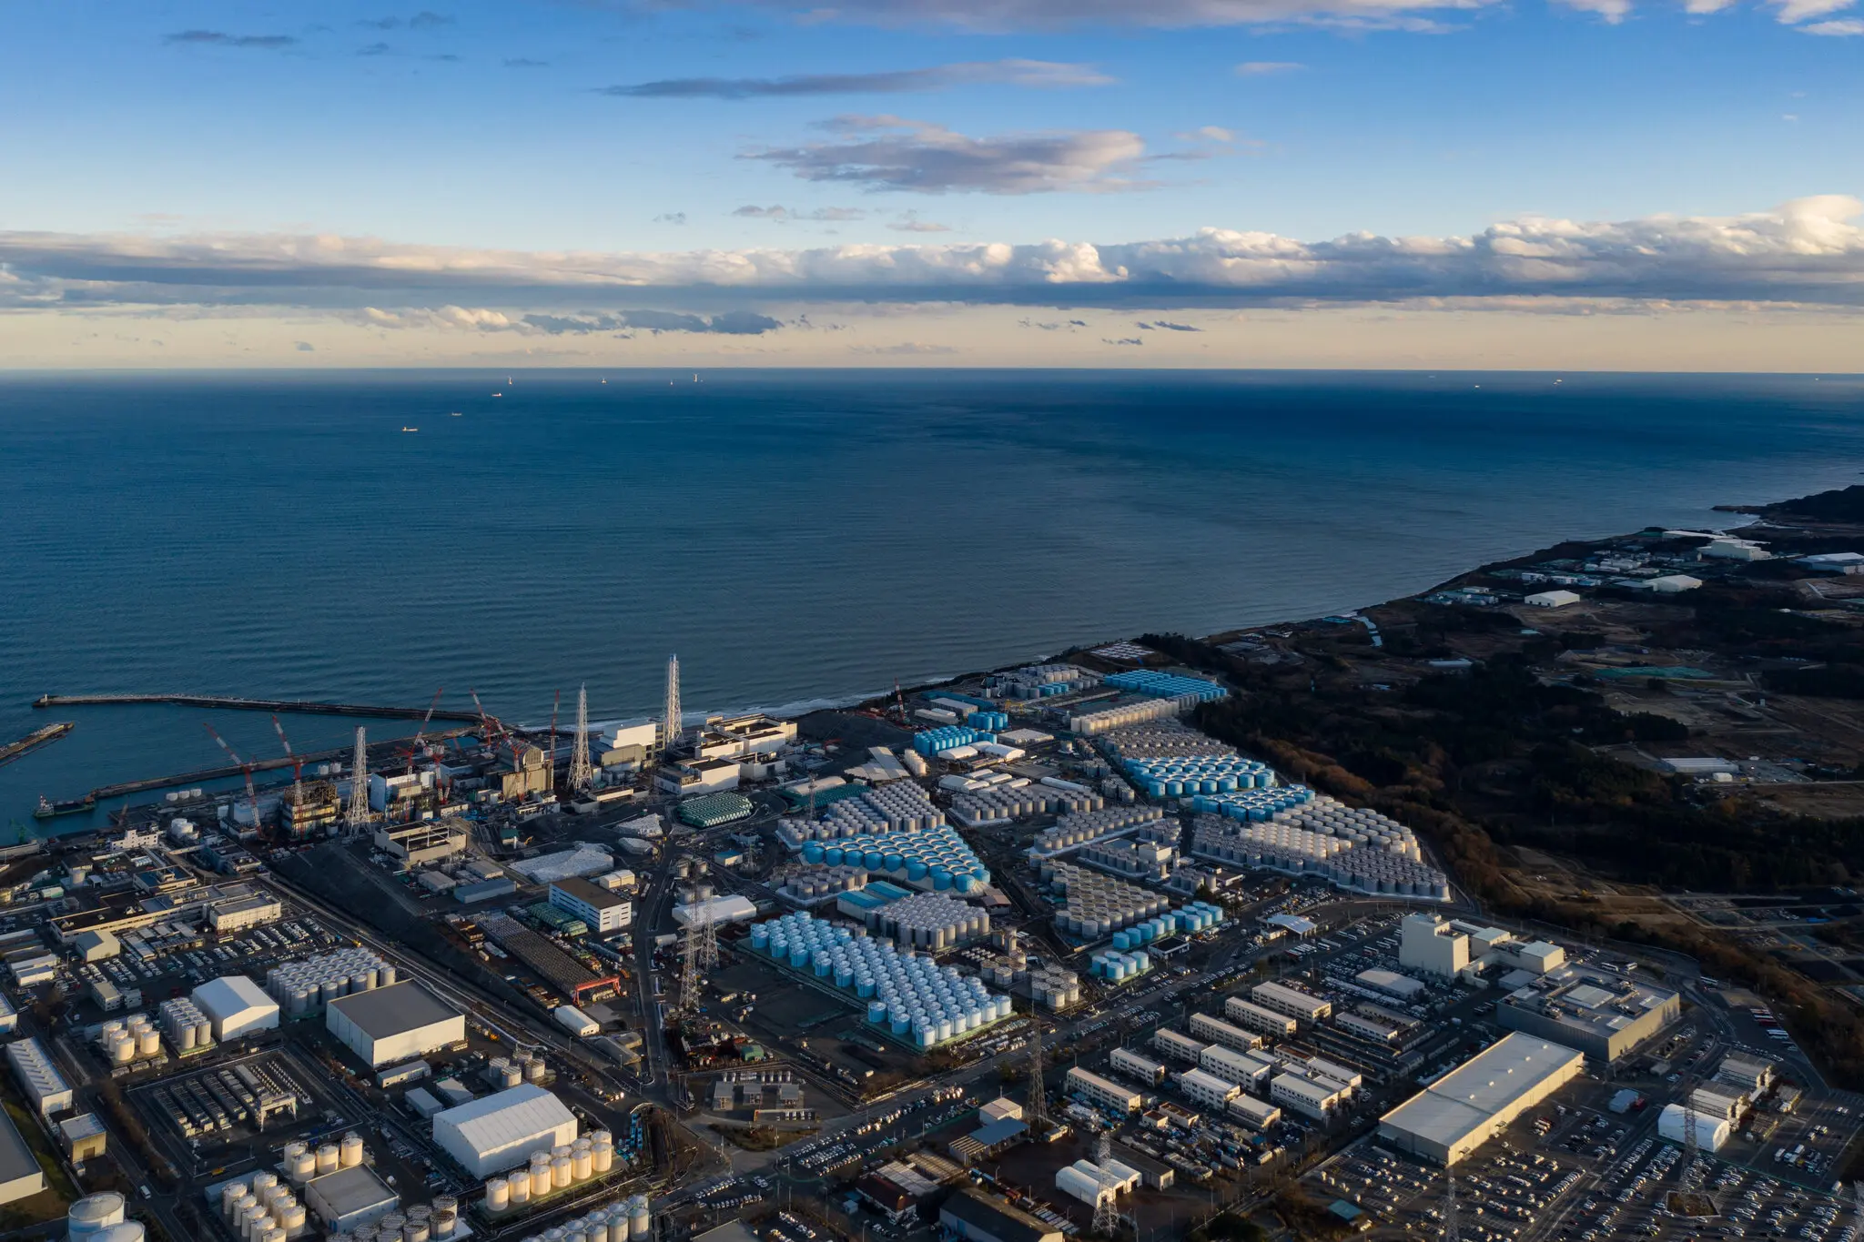
Introduction
This project proposes a Natural Disaster Sensing System to enhance safety in industrial environments by combining real-time earthquake detection with post-event gas leak monitoring. The system uses the SW-420 vibration sensor for detecting earthquakes, the MQ-135 gas sensor for identifying gas leaks, the ESP8266 Wi-Fi module and SIM-800A for enabling IoT-based remote monitoring and instant notifications.
Unlike traditional systems, this solution is proactive, offering early earthquake detection and targeted gas leak checks to prevent infrastructure damage and ensure human safety after seismic events.

Slide 4
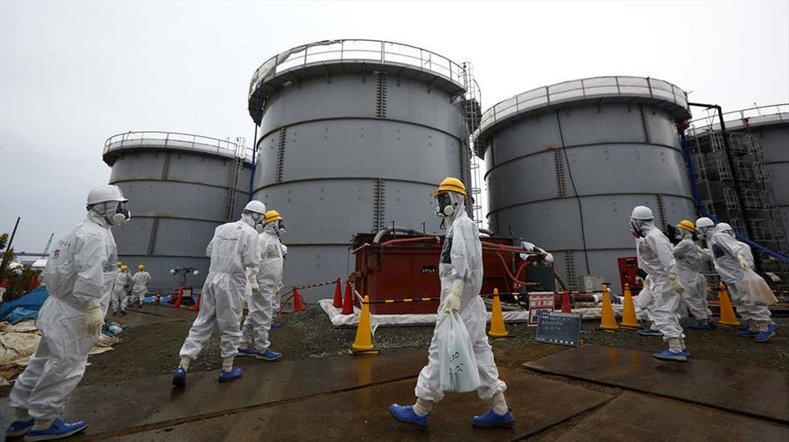
Our Mission
Our mission is to enhance industrial safety by providing real-time detection of earthquakes, floods, and heatwaves, combined with targeted gas leak monitoring, leveraging IoT technology for proactive risk mitigation and immediate response.

Slide 5
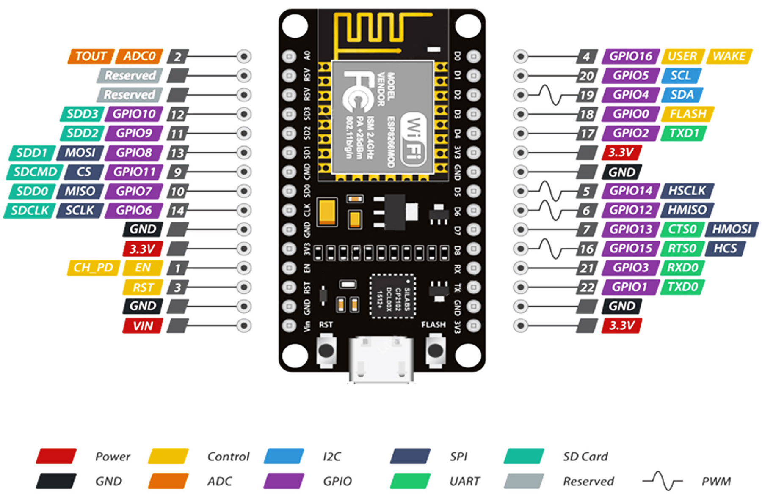
TOOLS :
ESP8266
The ESP8266 is used to control connected devices, receive signals from sensors such as the SW-420 , DHT-11 and MQ-135, and transmit the collected data to the Blynk platform. This enables seamless monitoring, remote access, and real-time updates for efficient management and response.

Slide 6
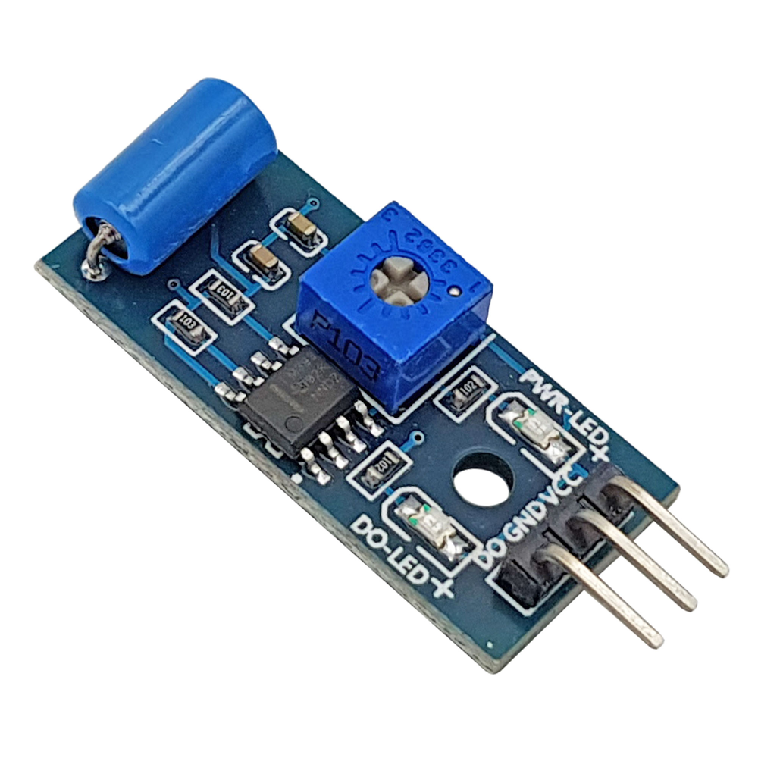
TOOLS :
SW-420
The SW-420 vibration sensor detects ground vibrations, crucial for earthquake detection. It provides a digital signal when vibrations exceed a set threshold, enabling integration with systems like the ESP8266 for alerts and monitoring.

Slide 7
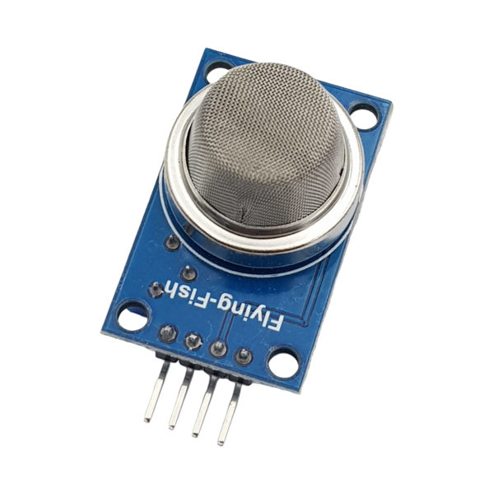
TOOLS :
MQ-135
The MQ-135 gas sensor detects harmful gases such as ammonia, carbon dioxide, smoke, and monitors air quality. In this system, it identifies gas leaks and assesses air quality after natural disasters, providing analog or digital output to the ESP8266 for real-time alerts and safety measures.

Slide 8

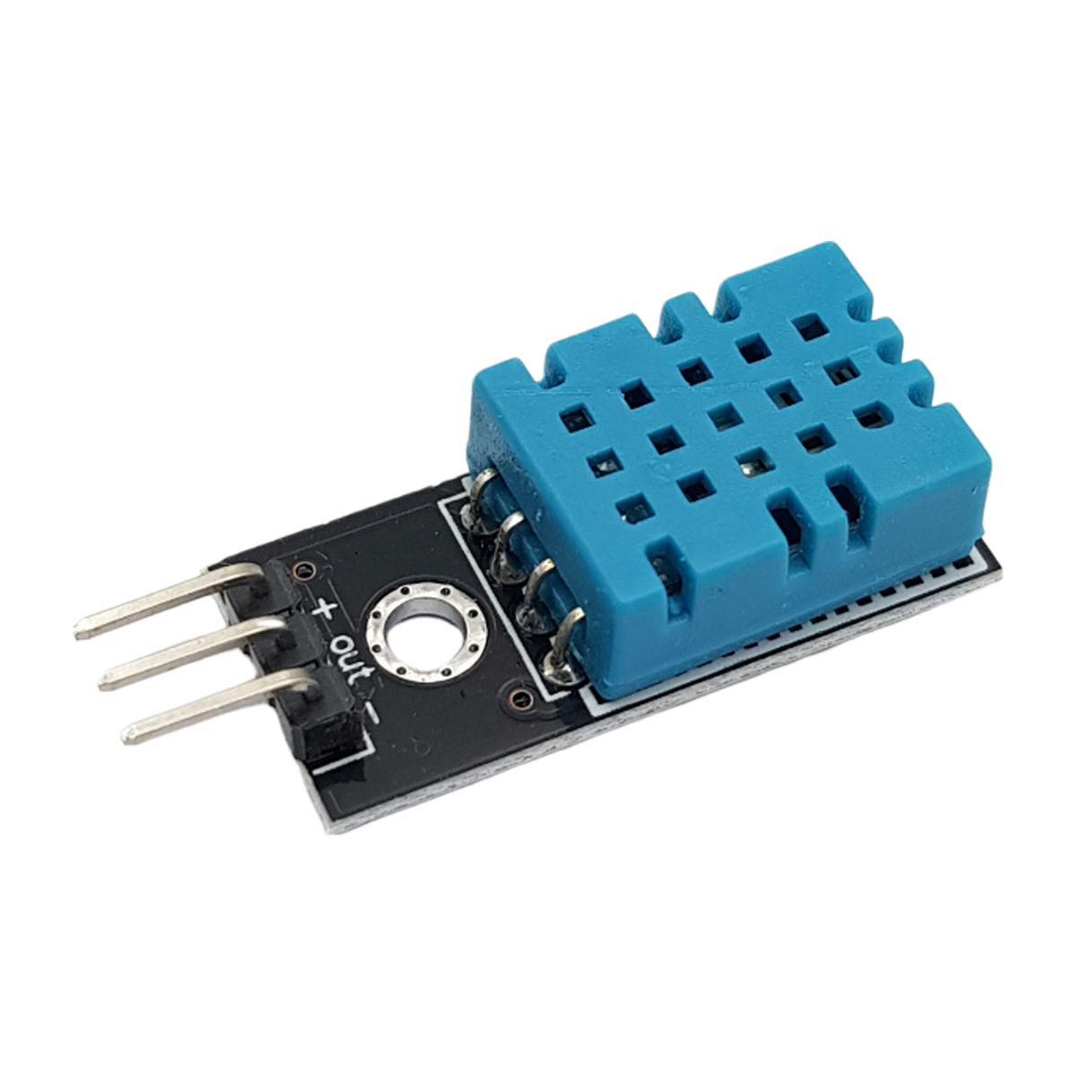
TOOLS :
DHT-11
The DHT11 sensor measures temperature and humidity, making it essential for monitoring environmental conditions. In this system, it helps track heatwaves and air moisture levels, providing digital output to the ESP8266 for real-time data analysis and alerts.

Slide 9
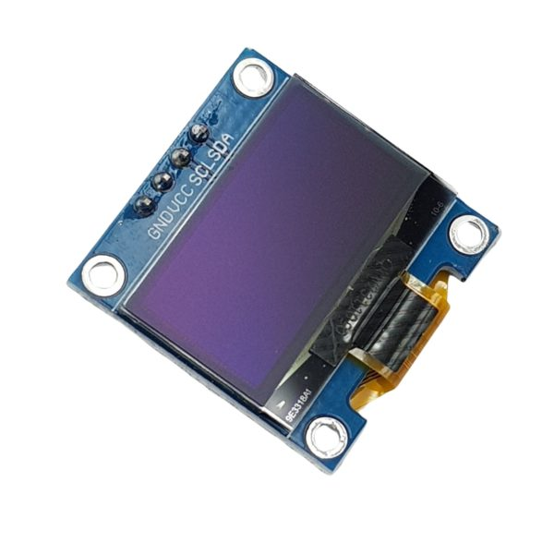
TOOLS :
OLED LCD
The 0.96-inch OLED LCD displays real-time data such as temperature, humidity, and air quality. It is used in this system to provide a clear and concise visual representation of environmental conditions, allowing users to monitor these parameters easily. The display receives data from sensors like the DHT11 (for temperature and humidity) and MQ-135 (for air quality), providing immediate feedback on the system's status.

Slide 10

TOOLS :
Button
The Button is used to manually test the system's tools and components after a long period of inactivity. By pressing the button, the system can activate and check the buzzer, LED indicators, and other components, ensuring they are functioning properly before they are needed in an emergency. This provides an easy way to verify the system's readiness.

Slide 11
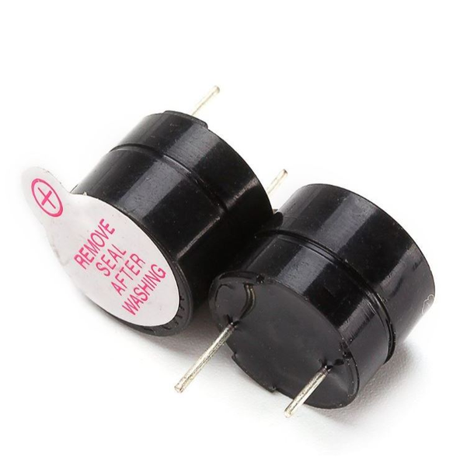
TOOLS :
Buzzer 3v
The 3V Buzzer is used in the system to provide audible alerts. It sounds off when critical conditions are detected, such as an earthquake, gas leak, or abnormal temperature and humidity levels. The buzzer is activated by the ESP8266 based on sensor readings, ensuring immediate attention and action during emergencies.

Slide 12
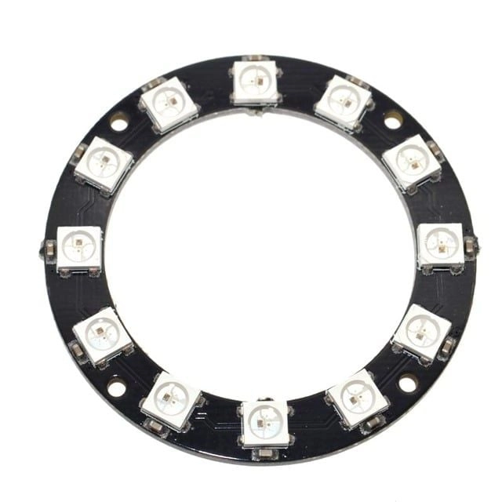
TOOLS :
NeoPixel Ring 12 RGB LED
The NeoPixel Ring with 12 RGB LEDs is used in the system to provide visual alerts and status indications. It can display various colors and patterns, signaling different conditions such as an earthquake, gas leak, or heatwave. The ESP8266 controls the NeoPixel Ring, allowing it to light up in specific colors (e.g., red for danger, green for normal) based on real-time data from the sensors. This enhances the system's ability to visually communicate urgent information.
Red : Flood , heat wave , air quality high , Vibration
While : Test board
Green : When air quality <= 50
Yellow : When air quality > 50 and <=100
Orange : When air quality > 100 and <=200
Purple : When air quality > 200 and <=300

Slide 13
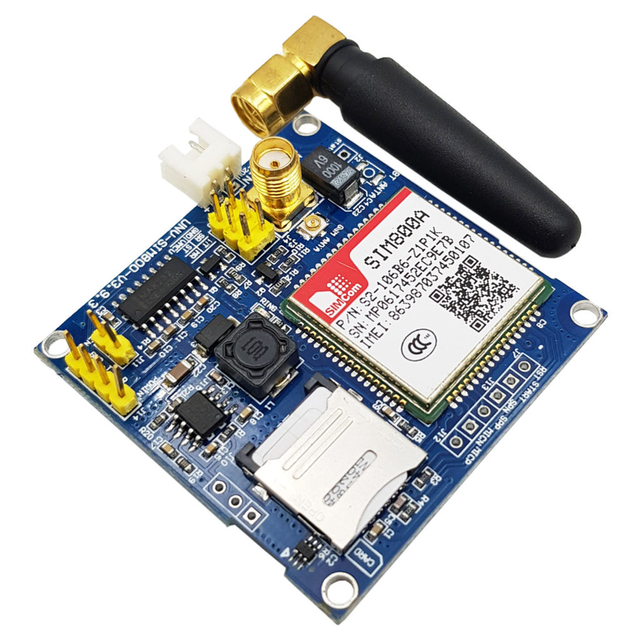
TOOLS :
SIM 800A
The SIM800A is a GSM/GPRS module used for communication in the system. It enables the sending of SMS alerts in case of critical events, such as detecting an earthquake, gas leak, or abnormal environmental conditions. The ESP8266 interfaces with the SIM800A to trigger emergency messages, ensuring immediate communication with users or emergency services even in remote areas without internet connectivity.

Slide 14

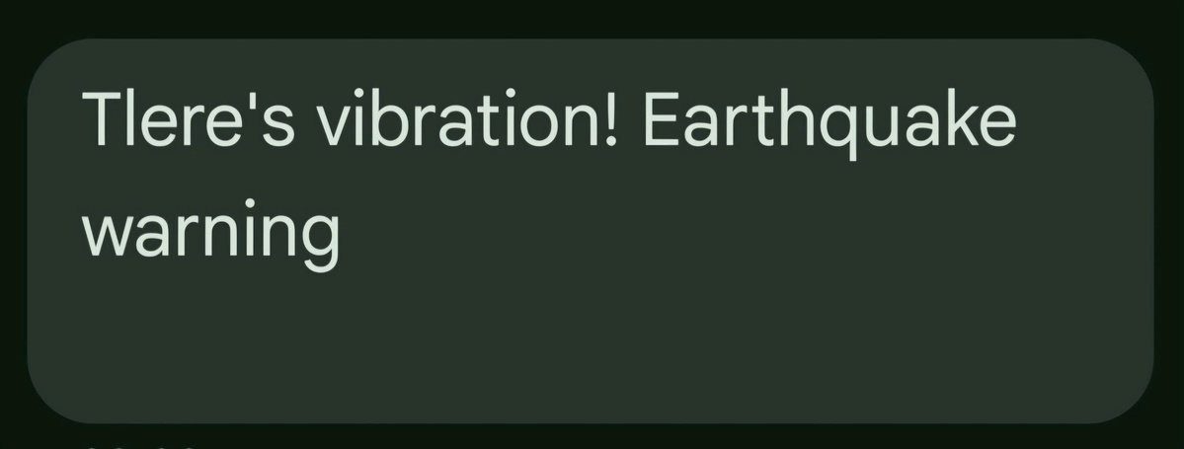
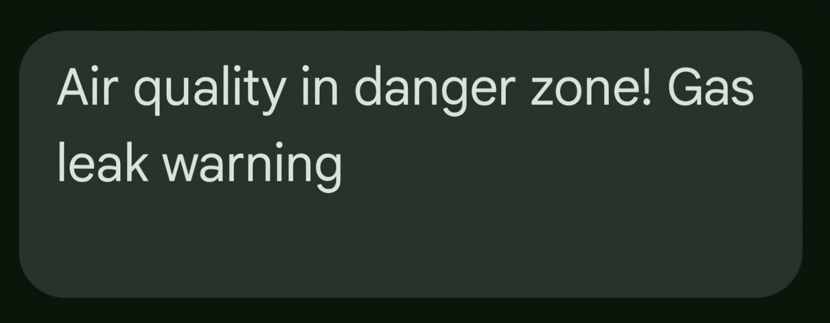
SMS warning
When the SW-420 sensor detects vibrations, the circuit processes the signal it receives, ensuring that the data is accurately interpreted. Once the processing is complete, the system initiates a response by sending a detailed notification or message directly to the connected phone, allowing the user to be promptly informed of the detected vibration event.
The MQ-135 sensor is designed to monitor air quality and detect gas leaks in the environment. Once it identifies any irregularities or hazardous conditions, the circuit processes the collected data and promptly sends a notification or message to the designated phone. This ensures timely alerts for better safety and environmental monitoring.

Slide 15
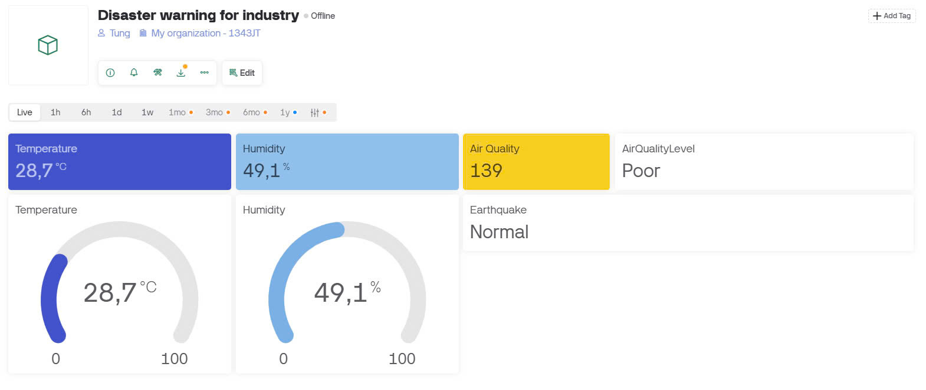
Blynk

Slide 16
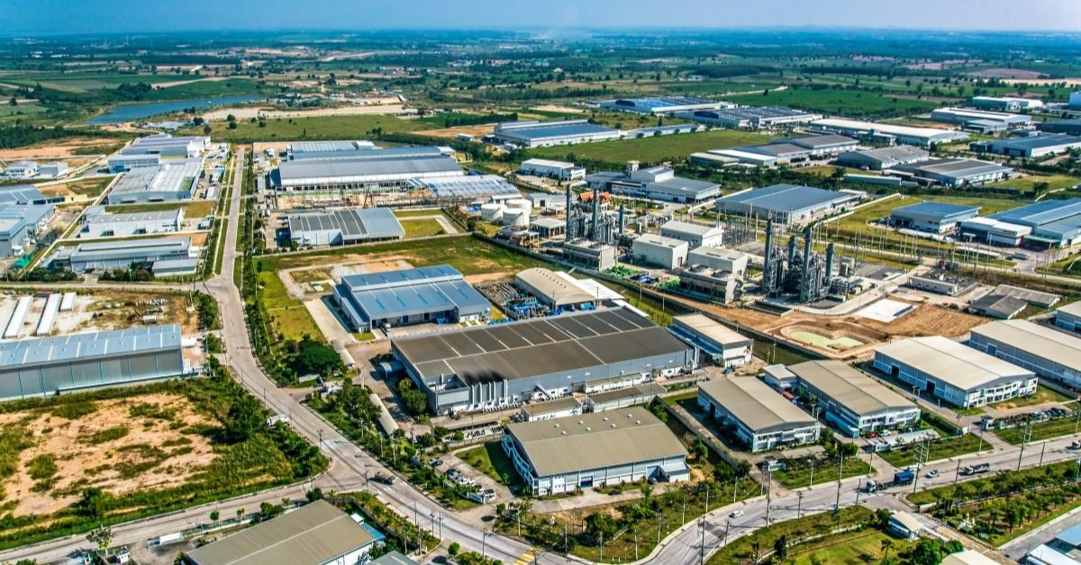
Conclusion
The use of ESP8266 as the central microcontroller, along with communication modules such as SIM-800A, enables real-time alerts and remote monitoring via IoT and GSM technologies. The inclusion of OLED displays, and NeoPixel RGB LEDs enhances user interaction and ensures immediate understanding of system status and alerts.
The Natural Disaster Sensor System provides a cost-effective solution for detecting earthquakes and gas leaks in industrial environments. By integrating affordable sensors like the SW-420 for vibration detection, MQ-135 for gas monitoring, and DHT-11 for environmental conditions, the system ensures reliable hazard monitoring at a low cost.
This system is not only effective in reducing risks associated with natural disasters but also scalable and adaptable for broader applications in industrial safety. By automating critical hazard detection and integrating robust communication features, the project demonstrates significant potential for real-world deployment, enhancing both safety and operational resilience.

Slide 17

THANK YOU!

